Slide 1
Application of Embedded Systems for Precision Timing Measurement and Machine Learning
Group:
Gavin Lewis 101617
Aditya Dsouza 101613
Shantanu Shinde 101651

Slide 2
Abstract
The primary application of our project will be at a Time to Digital Converter (TDC) which is an integral component of the Compact Muon Solenoid (CMS) experiment at CERN.
The TDC component is used to measure the time between the collisions of two elementary particles in the Large Hadron Collider.
This time measurement can be done efficiently by FPGAs as they can handle tasks parallel and produce very less delay in generation of results.
The FPGAs are able to compute the time between two collision pulses with high efficiency

Slide 3
Introduction
TDCs have been used in the field of particle and high energy physics to measure time between collisions.
Traditional approach employed Analog to Digital Converters(ADC)
Reasons to move to digital approach
Easy storage of data
No loss of info
DSP ensures inherent robustness against noise and process variations.
The digital approach ensures scaling and robustness. So mainly, including ADC seems important because that'll help anyone understand as to why one is going for the digital approach.

Slide 4
Literature Survey
Title | Authors | Methodology
Time-to-Digital Converter Basics (Time-to-Digital Converters Springer Series in Advanced Microelectronics, pp. 5–18,2010) | Henzler, S. | This chapter focuses briefly on the traditional method of measuring time-interval using Analog to Digital Converters(ADC) and their shortcomings and the advantages of using a Time to Digital Converter. It also briefly describes the basics of TDC and speaks about the basic delay line model.
Implementation of a 30 PS Resolution Time to Digital Converter in FPGA | Raguvaran Narasimman, Anil Prabhakar and Nitin Chandrachoodan | It briefly describes the two methods used widely for circuit architecture of TDCs-The Vernier Delay Method and the Tapped Delay Line Method. The implementation of TDC on the Spartan 3E FPGA results in producing a 30ps Resolution TDC. The methodology used is the “hybrid” approach combining the Vernier and the Tapped Delay Line method.
Design and characterization of a low-cost FPGA-based TDC | Tontini, A., Gasparini, L., Pancheri, L. and Passerone | It describes the implementation of the tapped delay line model on a low-cost, low-gate count Xilinx Spartan 6 FPGA of TDC with an LSB of 25.57ps.

Slide 5
Literature Survey (Cont.)
Title | Author(s) | Summary
A high-resolution programmable Vernier delay generator based on carry chains in FPGA. (2017) | Cui, K., Li, X. and Zhu, R. | It employs the Vernier Delay method on a Stratix 3 board by Altera to implement TDC achieving a resolution of 38.6 ps with a nominal supply of 1100mV
Simulation Studies of the Time Digitizer for the CMS Hadron Calorimeter Upgrade | Evan Bauer | Idea for Time-to-Digital Converter (TDC) as an upgrade to the Compact Muon Solenoid (CMS) detector and investigates simulations of the upgraded CMS detector in order to gain a better understanding of the TDC functionality in the upgraded CMS configuration.
Accelerating Compute-Intensive Applications with GPUs and FPGAs | Shuai Che, Jie Li, Jeremy W. Sheaffer, Kevin Skadron, John Lach | Comparitive study of diverse applications and algorithms on FPGA, GPU and Multicore Systems. They provide an application characteristic to accelerator performance mapping

Slide 6
Existing Systems – Fine Counter
Ramp Interpolator –
When counting is not feasible because the clock rate would be too high, analog methods can be used. Analog methods are often used to measure intervals that are between 10 and 200 ns. These methods often use a capacitor that is charged during the interval being measured.

Slide 7
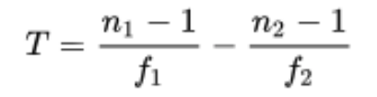
Existing Systems (Contd.)
2. Vernier Interpolator -
The Vernier method is a digital version of the time stretching method. Two only slightly detuned oscillators (with frequencies f 1 and f 2 ) start their signals with the arrival of the start and the stop signal. As soon as the leading edges of the oscillator signals coincide the measurement ends and the number of periods of the oscillators (n 1 and n 2 respectively) lead to the original time interval T:

Slide 8
Existing Systems (Contd..)
3. Tapped Delay Line -
In general a tapped delay line contains a number of cells with well-defined delay times. Propagating through this line the start signal is delayed. The state of the line is sampled at the time of the arrival of the stop signal. This can be realized for example with a line of D-flip-flop cells with a delay time. The start signal propagates through this line of transparent flip-flops and is delayed by a certain number of them. The output of each flip-flop is sampled on the fly. The stop signal latches all flip-flops while propagating through its channel un-delayed and the start signal cannot propagate further. Now the time interval between start and stop signal is proportional to the number of flip-flops that were sampled as transparent.

Slide 9
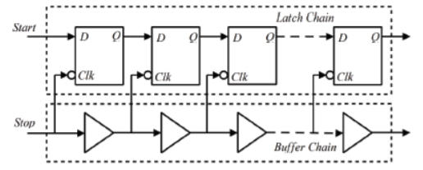

Slide 10
TDC 7200
TDC 7200 performs the function of a stopwatch and measures the elapsed time between a START pulse and up to five STOP pulses with a resolution of 55ps.
This elapsed time is also known as Time-of-Flight or TOF.
TDC 7200 has the ability to measure time with accuracy in the order of picoseconds.
This accuracy makes it for application such as flow water, where zero and low flow water require accuracy in the picoseconds range.

Slide 11
TDC 7200 consists of two counters: Coarse and Clock
TDC 7200 measures time using two measurement modes: Measurement Mode 1 and Measurement Mode 2
The Clock counter counts the number of integer clock cycles between the START and STOP pulses and is only used in Measurement Mode 2
Whereas, the Coarse counter counts the number of times the ring oscillator wraps in Measurement Mode 1
TDC 7200 uses a calibration mechanism in order to account for environmental variables (temperature, systematic noise, etc.).

Slide 12
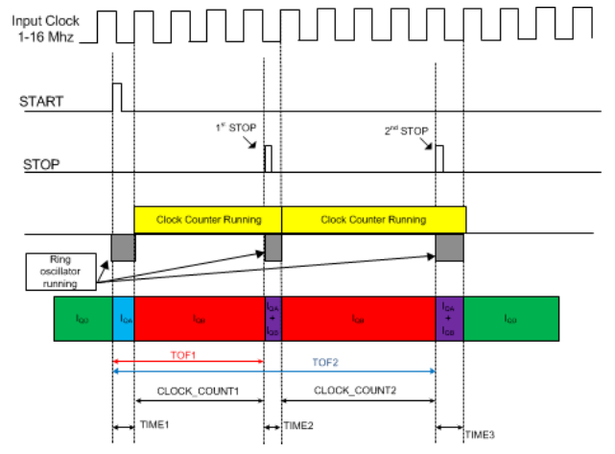

Slide 13
Proposed System
The combination of the fine counter with then pre-existing coarse counter to generate a Hybrid Counter

Slide 14
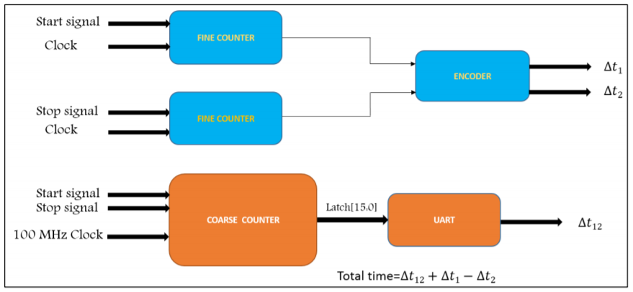
Block Diagram

Slide 15
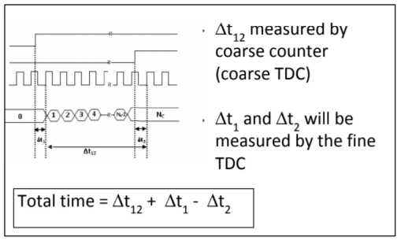

Slide 16
Software Requirements
For development purposes:
Vivado 2018.2/2019.1 ISE
Used to develop applications that are compatible and deployable on the Xilinx FPGA board.
The Vivado is used to synthesize and create a bit file for the FPGA
Digilent Adept
Digilent Adept is used to burn the FPGA bit file on the physical FPGA board.

Slide 17
Hardware Requirements
Xilinx Nexys 3 FPGA
Xilinx Nexys 4 FPGA / Xilinx Nexys A7 100T FPGA

Slide 18
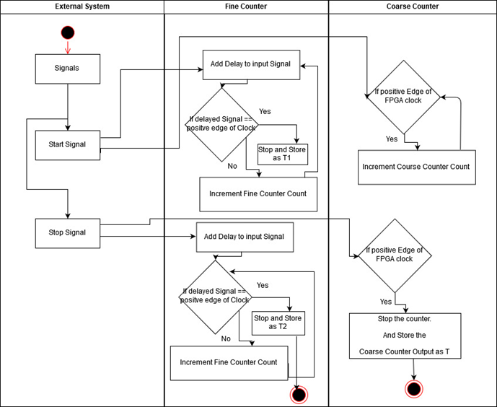
Design Of the Counter
Activity Diagram

Slide 19
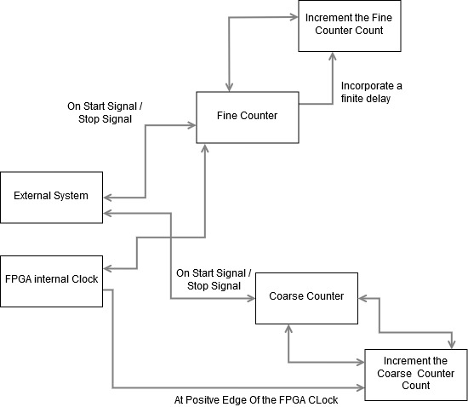
Design Of the Counter
Activity Diagram

Slide 20
Conclusion
Work Done :
Implemented synchronisation of an asynchronous input signal
Implemented Counting of the synchronised input signal
Understood port mapping for direct running of code on FPGA.
Work To Be Done :
Implementing coarse counter
Implementing fine counter
Integrating both into a Hybrid Counter.

Slide 21
References
https://www.xilinx.com/ - To understand the FPGA architecture and it’s design
S. Henzler, “Time-to-Digital Converter Basics,” Time-to-Digital Converters Springer Series in Advanced Microelectronics, pp. 5–18,2010.
J. Kalisz, et al., "Field-programmable-gate-array-based time-to-digital converter with 200-ps resolution," IEEE Trans. Instrum. Meas., vol. 46, pp. 51-55, 1997.
Narasimman, R., Prabhakar, A. and Chandrachoodan, N. (2015). Implementation of a 30 PS resolution time to digital converter in FPGA. 2015 International Conference on Electronic Design, Computer Networks & Automated Verification (EDCAV).
Tontini, A., Gasparini, L., Pancheri, L. and Passerone, R., 2018. “Design and characterization of a low-cost FPGA-based TDC.” IEEE Transactions on Nuclear Science, 65(2), pp.680-690.
Cui, K., Li, X. and Zhu, R., 2017. “A high-resolution programmable Vernier delay generator based on carry chains in FPGA.” Review of Scientific Instruments, 88(6), p.064703.
http://www.asic-world.com/verilog/veritut.html

